Slide 1

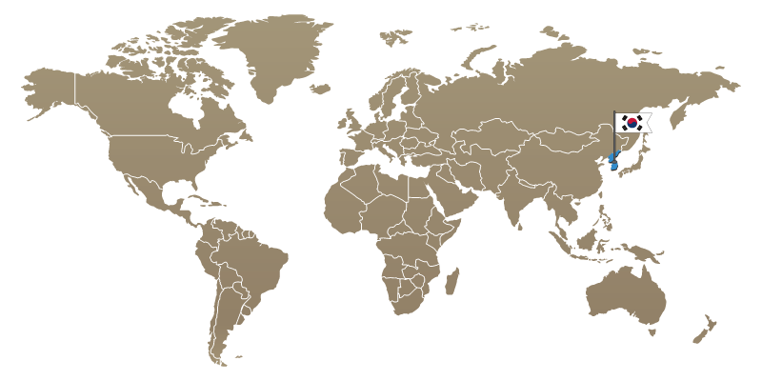

LizarMong: Excellent KEM/PKE based on RLWE and RLWR
서울대학교 정치곤, 국민대학교 이종혁, 한양대학교 주영진, 한성대학교 권용빈
<fig. refer: https://csrc.nist.gov/CSRC/media/Presentations/Lizard/images-media/Lizard-April2018.pdf >

Slide 2
Contents
Motivation
Detail to LizarMong
Specifications
Security Analysis
Correctness Analysis
Resistance to known side-channel attacks
Evaluation
Conclusion
Q&A

Slide 3
Motivation

Slide 4



Motivation
국산 양자내성 암호를 국제 표준으로!!

Slide 5
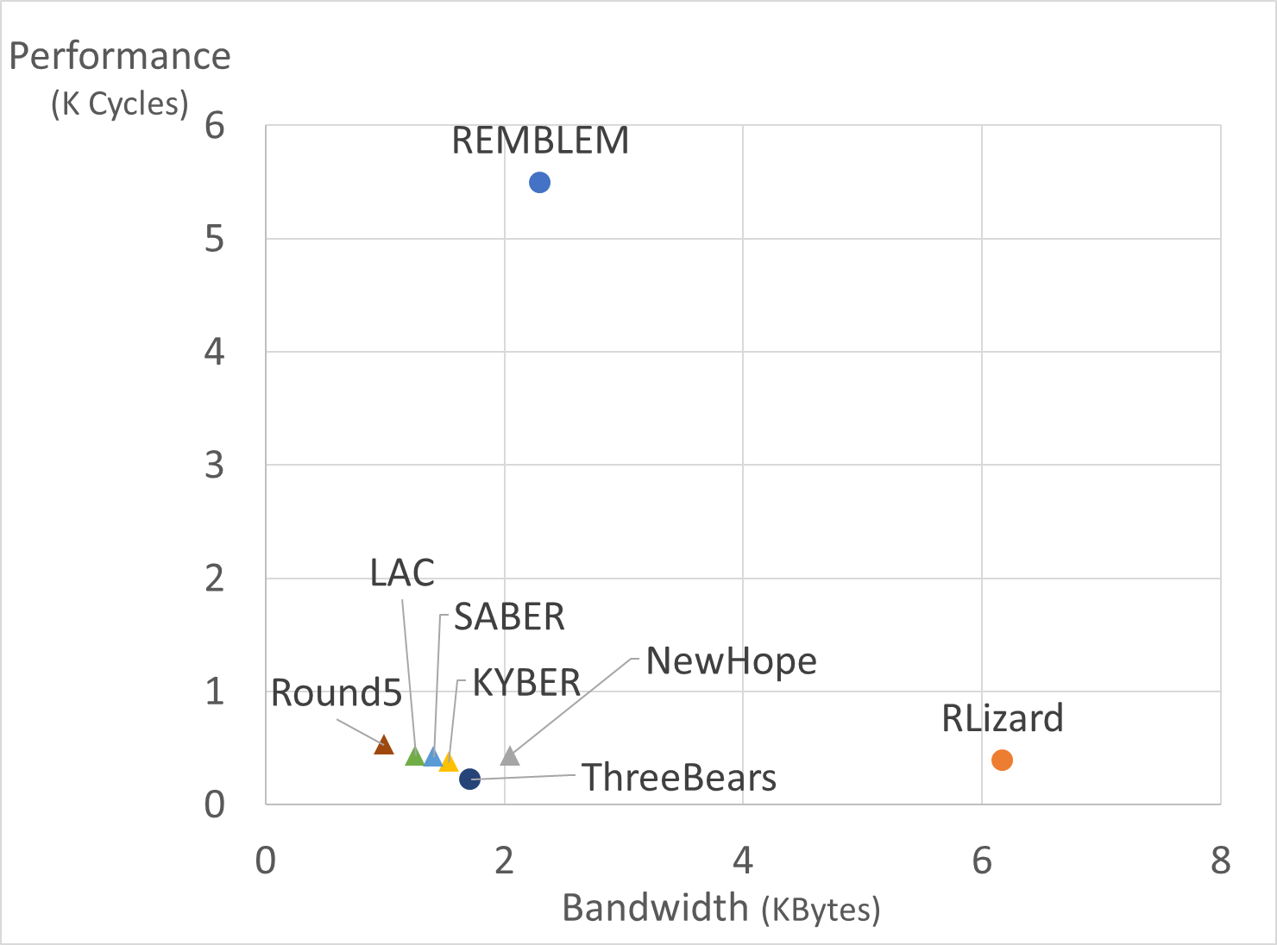
What is the Gap?
Algorithm | Classical security (log) | Correctness (log)
RLizard | 147 | -188
REMBLEM | 128 | -140
NewHope | 112 | -213
KYBER | 111 | -178
SABER | 125 | -120
Round5 | 128 | -88
LAC | 147 | -116
ThreeBears | 154 | -156
< Performance and Bandwidth of 128-bit security KEM >
< Clamed security and Correctness of 128-bit security KEM >
RLizard: Bandwidth
REMBLEM: Performance (+ only support128-bit security level)
* Performance(keygen+enc+dec): The result of measuring optimal implementation code submitted to NIST in the same machine(i7-9700K and GCC –O3).
* Bandwidth(pk+ctx), Security, and Correctness: Referenced the paper submitted to NIST.

Slide 6
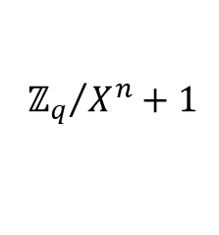
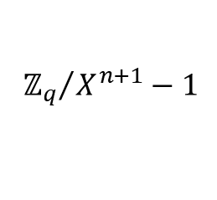
NIST candidate algorithms are perfect? (classification)
Large Modulus
(2¹²~2¹⁴)
Small Modulus
(2⁸~2¹²)
< General pros and cons >
RLWE
RLWE
RLWE
RLWE
NewHope
Good performance and bandwidth, well studies than others.
NewHope
LAC
LAC
Bandwidth↑
Performance↓
Correctness↑
Bandwidth↓
Performance↑
Correctness↓
MLWE
MLWE
Reduce bandwidth, but more computation than same dimension RLWE.
KYBER
KYBER
Fast Multiplication
Compress tech.
Error-correcting code
Tiny secret and errors.
RLWR
RLWR
MLWR
RLWR
MLWR
Round5
Better performance and bandwidth compare to RLWE and MLWE.
Round5
SABER
Round5
SABER
$${ℤ_{q}}/{X^{n}}+1$$
Common choice
I-MLWE
$${ℤ_{q}}/{X^{n+1}}−1$$
For small bandwidth
Overall looks good. However, the hardness is unclear in practical parameters.
ThreeBears

Slide 7
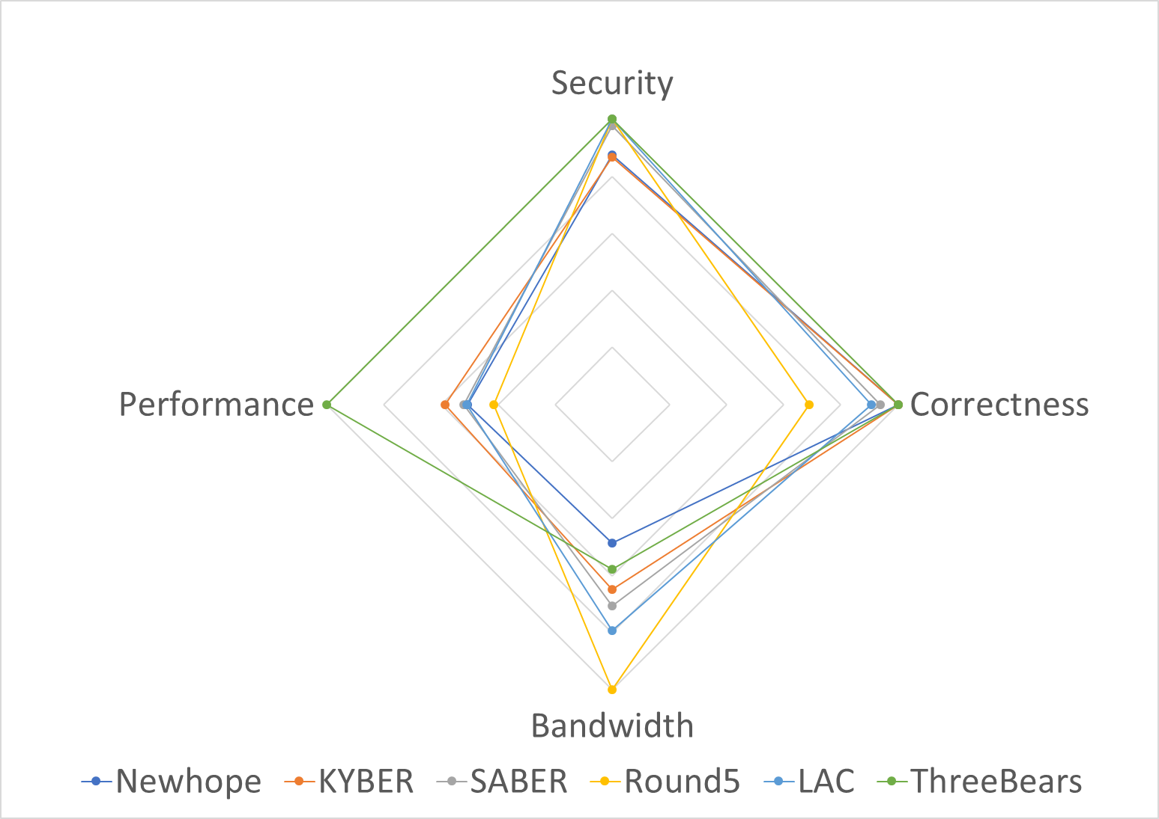
NIST candidate algorithms are perfect?
< Compare to 128-bit security KEM >
Which is the best?
All evaluation criteria are important.
NIST said “Still open to mergers.”
Most of latest studies are not included.
Especially, Side-channel attacks?
Error in each bit occurs independently?
★Goal: Making the excellent algorithm of all aspect based on RLizard ★

Slide 8
Detail to LizarMong

Slide 9

Specification of LizarMong
Design elements
Reduce the bandwidth and maintain the RLizard’s strengths.
Minimized known side-channel attack points.
Compare | Underlying Problem | Ring | Compress | Modulus | ECC | Distributions
 |  |  |  |  |  | Secret | Error
LizarMong | RLWE+RLWR |  | Yes | Small (fixed 2⁸) | XE5 | Uniform sparse ternary | Binomial (std≈0.7)
RLizard | 〃 | 〃 | No | Small (2^{10~12}) | None | 〃 | Gaussian CDT (std≈1.15)
$$ℤ_{q}/X^{n}+1$$
Why? | Key: conservative Enc/Dec: Fast | Fast / secure | Bandwidth | Bandwidth, Performance | Correctness, Side-channel | Correctness, Performance | Side-channel Correctness, Performance
Proved | - | - | Common in NIST’s Alg. | [PRSD17] | [Saa17] | - | [ADPS16]

Slide 10
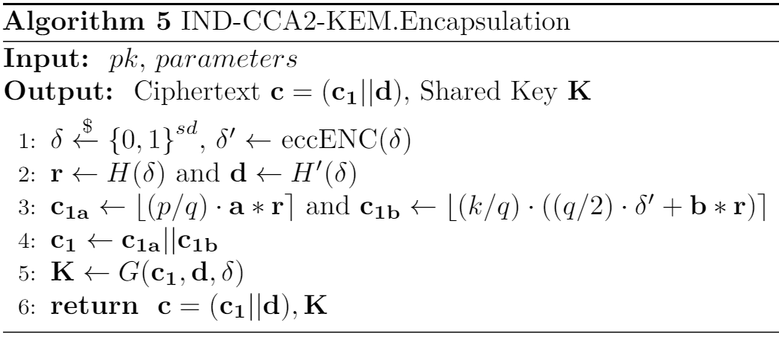
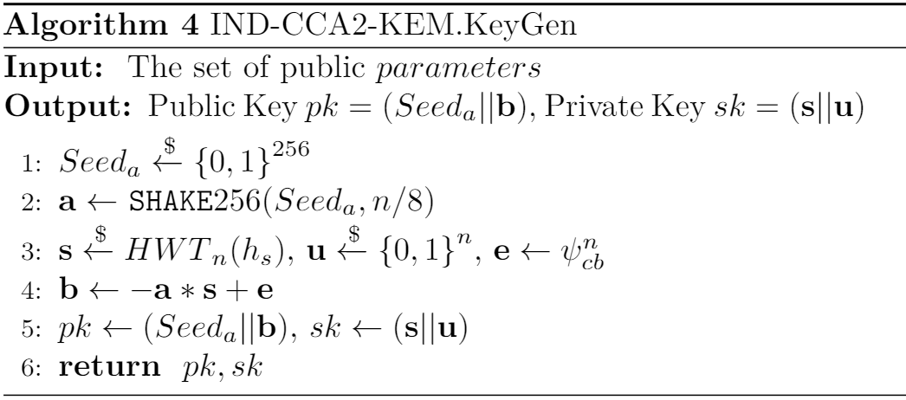
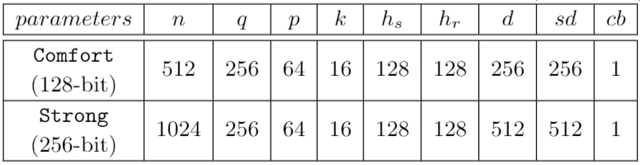
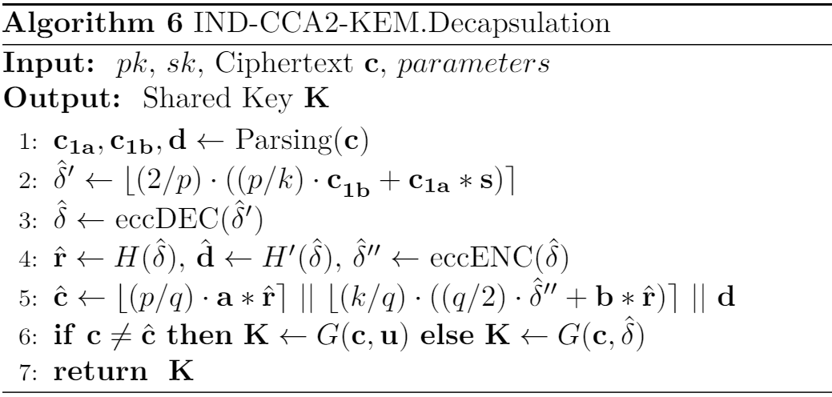
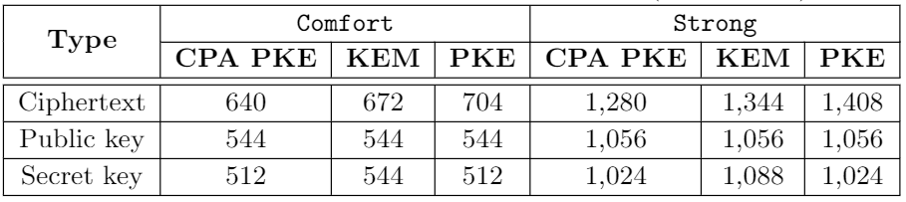
Specification of LizarMong
IND-CCA2 KEM
< Parameters for each security level >
< Bandwidth for each security level (unit: bytes) >
11-6

Slide 11
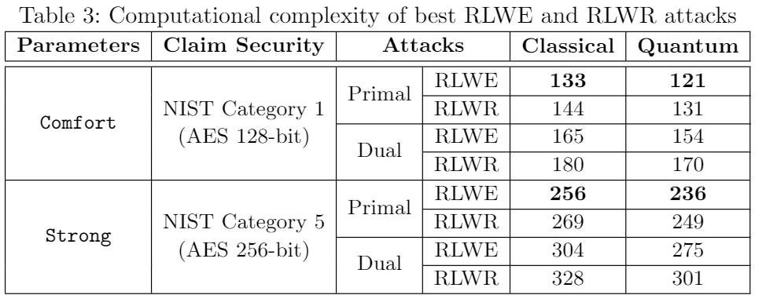
Security analysis
Security Proof
Cryptanalytic attacks
Assume the attacks are using BKZ.sieve.
Computational complexity measure core SVP.
use ‘online LWE estimator’ [Alb17].
Consider Dual and Primal attack like RLizard.
RLWE / RLWR
Lemma 1.
RLizard (IND-CPA PKE)
Theorem 1.
Under the assumption that SHAKE256 is ROM
LizarMong
(IND-CPA PKE)
A variants of Fujisaki-Okamoto Transformation [HHK17]
LizarMong
(IND-CCA2 KEM/PKE)
11-7

Slide 12




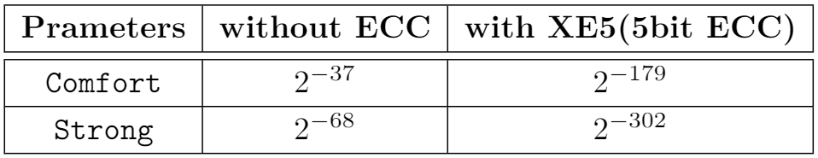
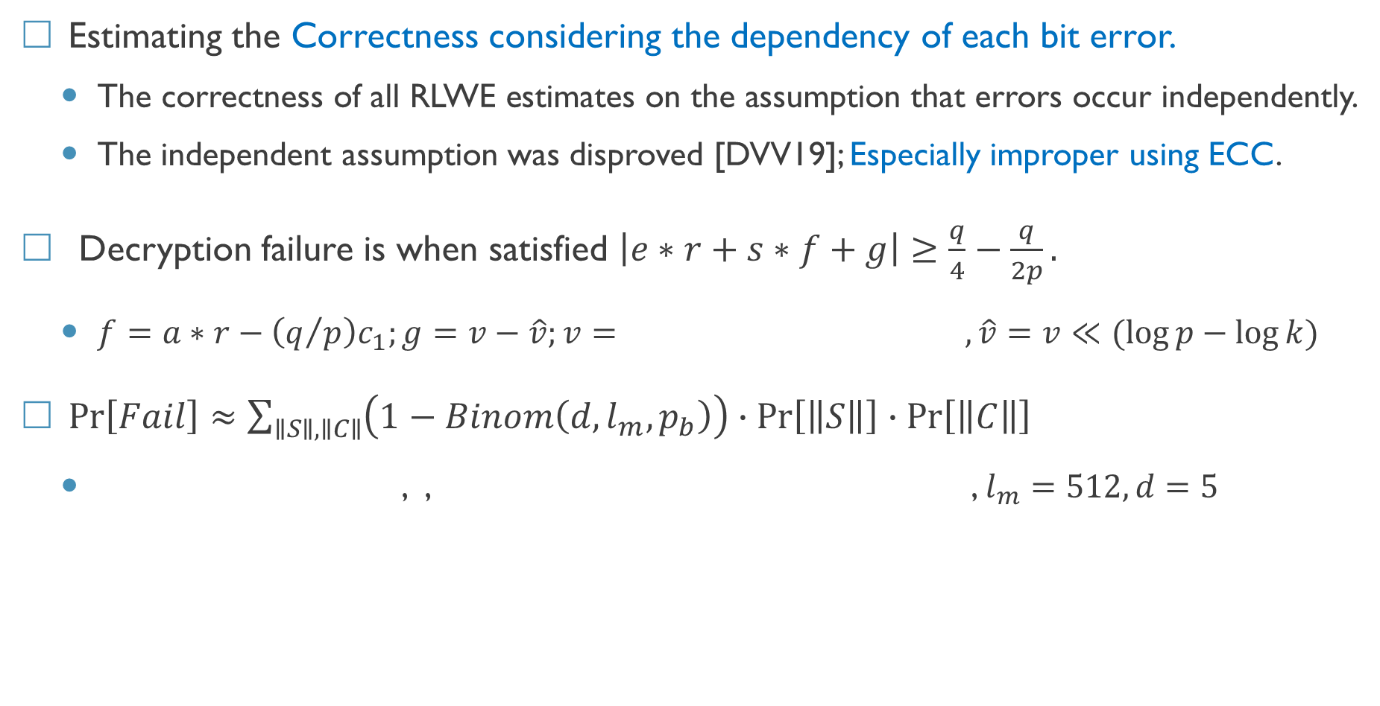
Correctness analysis
Estimating the Correctness considering the dependency of each bit error.
The correctness of all RLWE estimates on the assumption that errors occur independently.
The independent assumption was disproved [DVV19]; Especially improper using ECC.
Decryption failure is when satisfied $\left|e∗r+s∗f+g\right|≥\frac{q}{4}−\frac{q}{2p}.$
$f=a∗r−\left(q/p\right)c_{1};g=v−\hat{v};v= , \hat{v}=v≪(\log{p}−\log{k)}$
$\operatorname{Pr}\left[Fail\right]≈\sum_{∥S∥,∥C∥}{\left(1−Binom\left(d, l_{m},p_{b}\right)\right)∙\operatorname{Pr}\left[\left\|S\right\|\right]∙\operatorname{Pr}\left[\left\|C\right\|\right]}$
, , , $l_{m}=512, d=5$

Slide 13
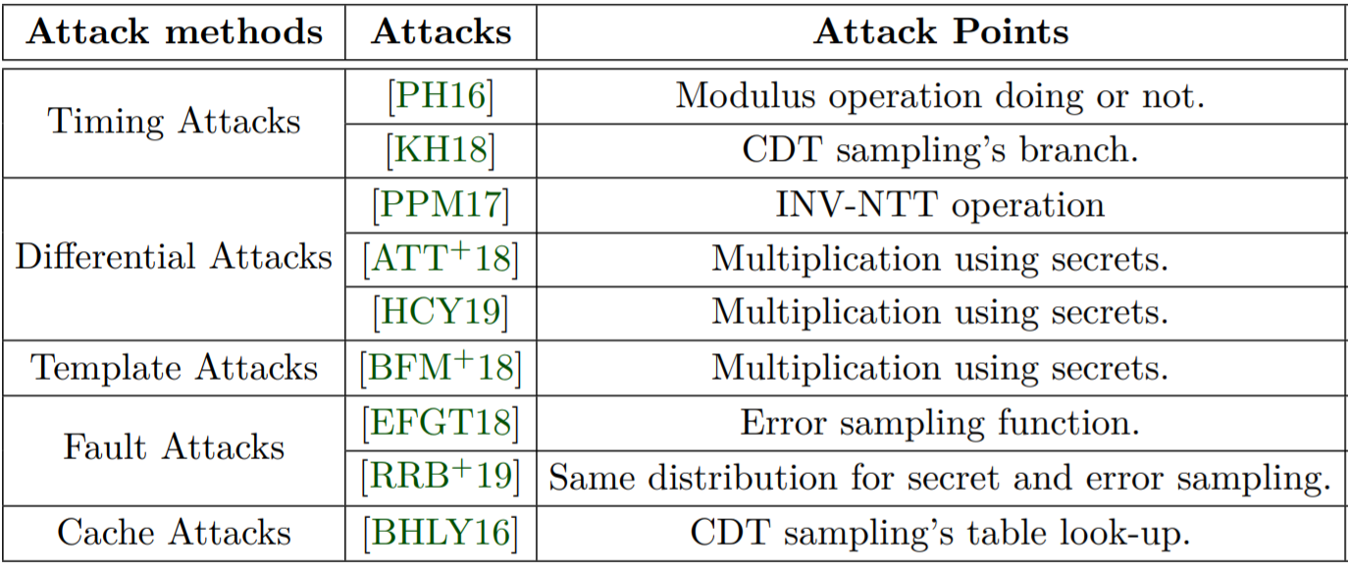
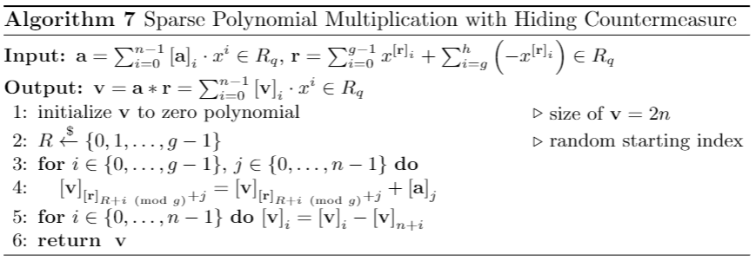
Resistance to known side-channel attacks
We investigated the known major side-channel attacks and the points they exploited.
Our strategy
First, ruled out the targeted by the known attacks during the design element selection.
Second, internalizes efficient countermeasures for unavoidable vulnerabilities.
AND, ADD, and SHIFT instead of Modulus Op.
Do not use NTT
Devised sparse polynomial multiplication with Hiding
Check the final loop index
Distributions of secret and error are different
Replaced with centered binomial distribution
11-9

Slide 14
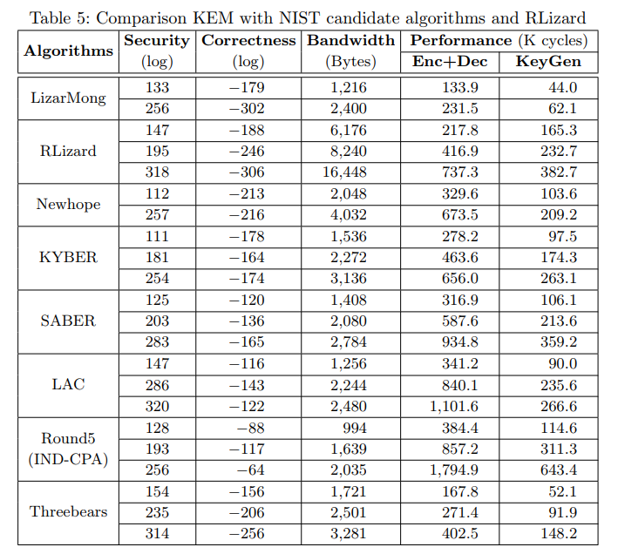
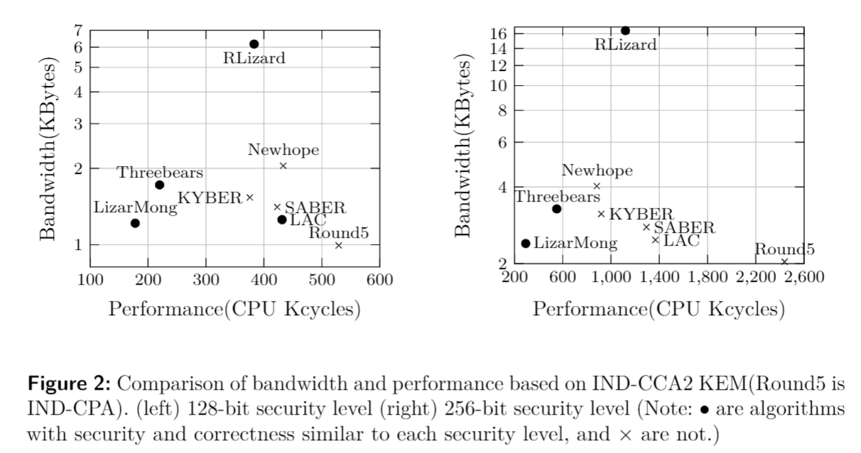
Evaluation
Compare to RLizard,
Band.: 80~85% smaller / Perfor.: 2.1~3.8x faster
Compare to NIST’s candidate Algorithms,
Band.: 3~41% smaller / Perfor.: 2.0~8.3x faster
11-10

Slide 15
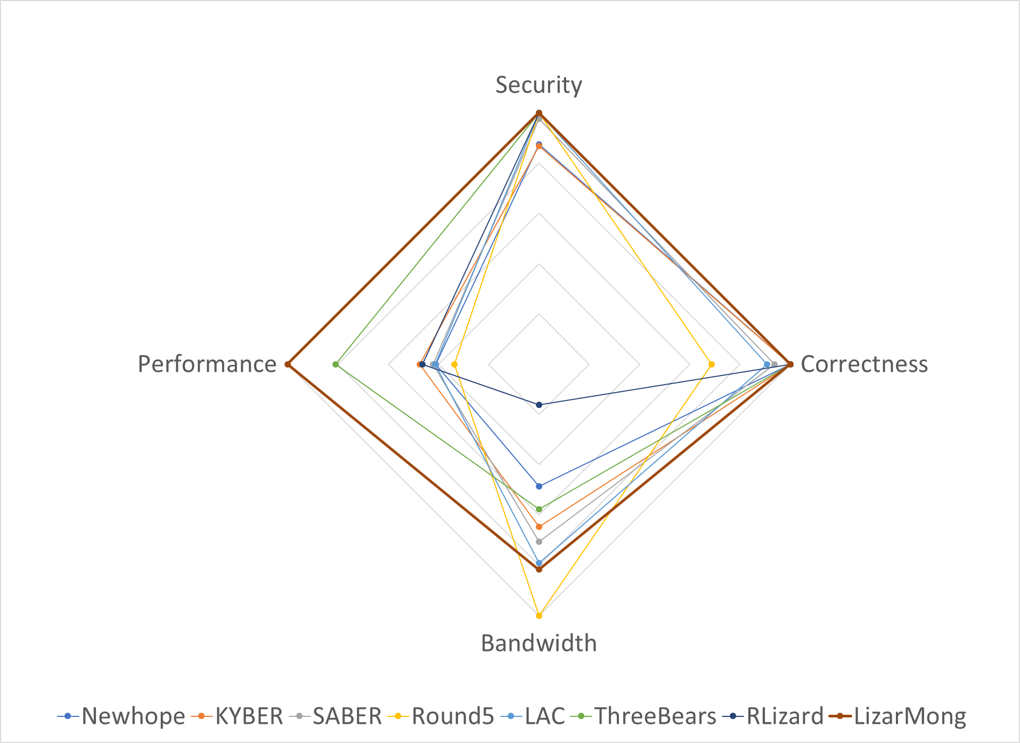
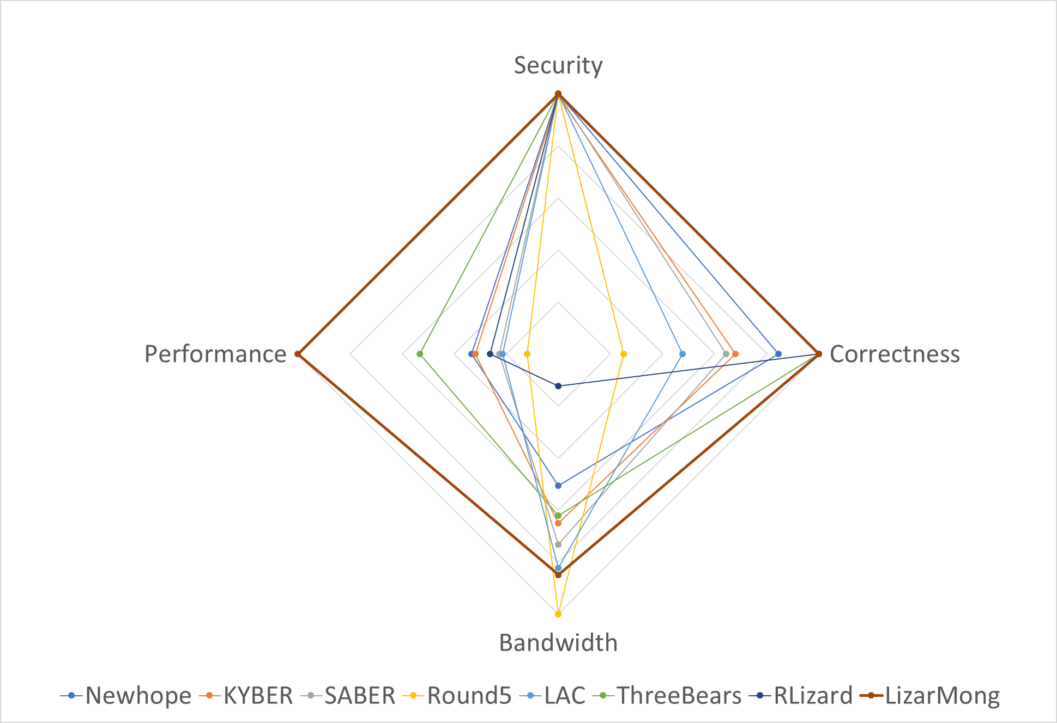
Conclusion
< 128bit security >
< 256bit security >
★ LizarMong is excellent of all aspect! Let’s Go International standard! ★
11-11

Slide 16
Have any Questions? Thank you!
<fig. refer: https://csrc.nist.gov/CSRC/media/Presentations/Lizard/images-media/Lizard-April2018.pdf >

Slide 17
References
[ATT+18] Aydin Aysu, Youssef Tobah, Mohit Tiwari, Andreas Gerstlauer, and Michael Orshansky. Horizontal side-channel vulnerabilities of post-quantum key
exchange protocols. In 2018 IEEE International Symposium on Hardware Oriented Security and Trust (HOST), pages 81–88. IEEE, 2018.
[ADPS16] Erdem Alkim, Léo Ducas, Thomas Pöppelmann, and Peter Schwabe. Post-quantum key exchange a new hope. In 25th {USENIX} Security
Symposium ({USENIX} Security 16), pages 327–343, 2016.
[Alb17] MR Albrecht. A sage module for estimating the concrete security of learning with errors instances (2017).
[BFM+18] Joppe W Bos, Simon Friedberger, Marco Martinoli, Elisabeth Oswald, and Martijn Stam. Assessing the feasibility of single trace power analysis of
frodo. In International Conference on Selected Areas in Cryptography, pages 216–234. Springer, 2018.
[BHLY16] Leon Groot Bruinderink, Andreas Hülsing, Tanja Lange, and Yuval Yarom. Flush, gauss, and reload–a cache attack on the bliss lattice-based
signature scheme. In International Conference on Cryptographic Hardware and Embedded Systems, pages 323–345. Springer, 2016.
[DVV19] Jan-Pieter D’Anvers, Frederik Vercauteren, and Ingrid Verbauwhede. The impact of error dependencies on ring/mod-lwe/lwr based schemes.
In International Conference on Post-Quantum Cryptography, pages 103–115. Springer, 2019.
[EFGT18] Thomas Espitau, Pierre-Alain Fouque, Benoit Gerard, and Mehdi Tibouchi. Loop-abort faults on lattice-based signature schemes and key exchange
protocols. IEEE Transactions on Computers, 67(11):1535–1549, 2018.
[HCY19] Wei-Lun Huang, Jiun-Peng Chen, and Bo-Yin Yang. Correlation power analysis on ntru prime and related countermeasures. IACR Cryptology ePrint
Archive, 2019:100, 2019.
[KH18] Suhri Kim and Seokhie Hong. Single trace analysis on constant time cdt sampler and its countermeasure. Applied Sciences, 8(10):1809, 2018
[PH16] Aesun Park and Dong-Guk Han. Chosen ciphertext simple power analysis on software 8-bit implementation of ring-lwe encryption. In 2016 IEEE
Asian Hardware-Oriented Security and Trust (AsianHOST), pages 1–6. IEEE, 2016.
[PPM17] Robert Primas, Peter Pessl, and Stefan Mangard. Single-trace side-channel attacks on masked lattice-based encryption. In International Conference
on Cryptographic Hardware and Embedded Systems, pages 513–533. Springer, 2017.
[PRSD17] Peikert, C., Regev, O., Stephens-Davidowitz, N.: Pseudorandomness of ring-lwe for any ring and modulus. In: Proceedings of the 49th Annual ACM
SIGACT Symposium on Theory of Computing. pp.461–473. ACM (2017)
[RRB+19] Prasanna Ravi, Debapriya Basu Roy, Shivam Bhasin, Anupam Chattopadhyay, and Debdeep Mukhopadhyay. Number “not used” once-practical
fault attack on pqm4 implementations of nist candidates. In International Workshop on Constructive Side-Channel Analysis and Secure Design,
pages 232–250. Springer, 2019.
[Saa17] Markku-Juhani O. Saarinen. Hila5: On reliability, reconciliation, and error correction for ring-lwe encryption. Cryptology ePrint Archive, Report
2017/424, 2017. https://eprint.iacr.org/2017/424.
[HHK17] Dennis Hofheinz, Kathrin Hövelmanns, and Eike Kiltz. A modular analysis of the fujisaki-okamoto transformation. In Theory of Cryptography
Conference, pages 341–371. Springer, 2017.

Slide 18


Compress techniques
All NIST candidate algorithms commonly use compression techniques.
Public-key: Sending only the gen_a_seed instead of $a∈R_{q}$, and recovers using a hash.
* pk size: $2n\log{q} →\left|gen_a_seed\right|+n\log{q}$.
Ciphertext: Discarding a few bits of LSB in $c_{2}$.
* ctx size: $2n\log{p} →n\log{p}+n\log{k}, where k<p is compress modulus$
How does compress affect the scheme?
How is the size of gen_a_seed?
NIST candidate algorithms use 128 or 256bit. we choose 256bit from a conservative.
Ciphertext compress reduce the correctness?
Yes! However, we already include it in calculation of the failure rate.

Slide 19


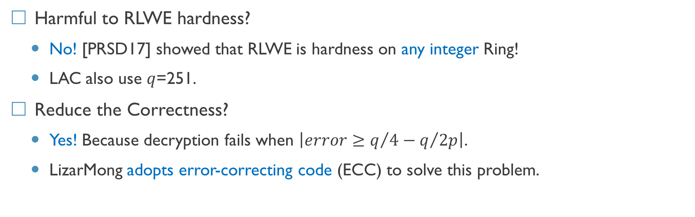
Small modulus fixed at 2⁸
Reduce bandwidth: to make lattice dimension $n$and RLWE modulus $q$ small.
Since the ring , the smaller $n$ is 256; however, difficult to satisfy security.
Therefore our choice is only to make $q$ smaller.
How does small $q$ affect the scheme?
$$ℤ_{q}/X^{n}+1$$
Harmful to RLWE hardness?
No! [PRSD17] showed that RLWE is hardness on any integer Ring!
LAC also use $q$=251.
Reduce the Correctness?
Yes! Because decryption fails when $\left|error≥q/4−q/{2p}\right|$.
LizarMong adopts error-correcting code (ECC) to solve this problem.

Slide 20
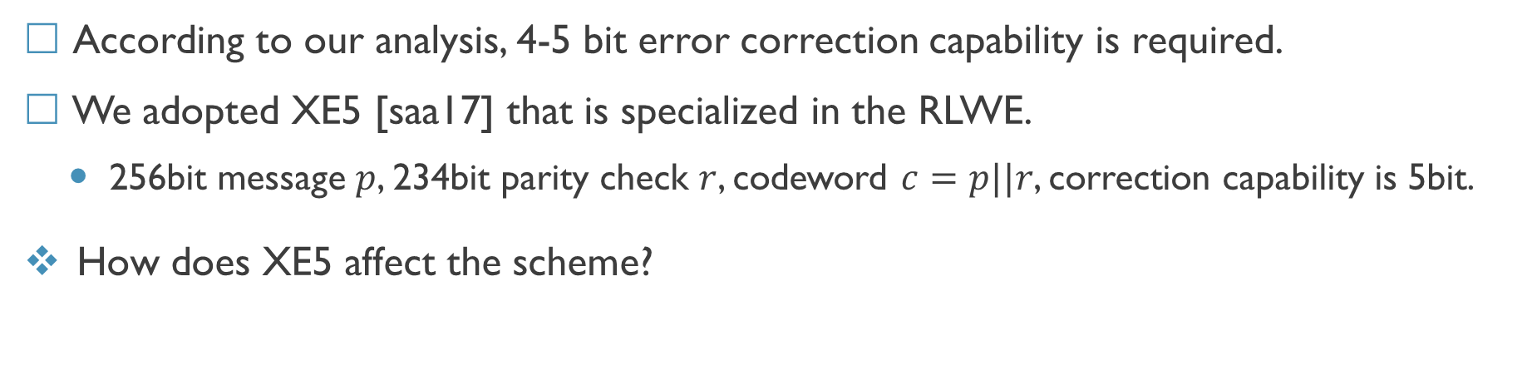
Error-correcting code, XE5
According to our analysis, 4-5 bit error correction capability is required.
We adopted XE5 [saa17] that is specialized in the RLWE.
256bit message $p$, 234bit parity check $r$, codeword $c=p||r$, correction capability is 5bit.
How does XE5 affect the scheme?
Performance overhead? Yes! But, it is very small (only 600 cycles).
Side-channel attacks?
No! [saa17] argues XE5 resist timing attack as avoid table look-up and branch;
The impact of error dependencies?
Yes! The calculation is improper when the error-correcting code is used [DVV19].
To solve, calculate the failure rate under the assumption that error occurs dependently.

Slide 21
Resistance known side-channel attacks (1/2)
According to the 1st strategy, against known cache and timing attacks, also some differential and fault attacks.
Modulus operation ☞ choice all modulus are power-of-two. So, AND and ADD instead of it.
CDT branch and table look-up ☞ CDT was replaced with centered binomial distribution.
Same distribution for error and secret ☞ Distribution of secret and error are different.
INV-NTT ☞ do not use NTT.
How does this design choice affect the scheme?
Centered binomial distribution ?
Proved similarity with the Gaussian distribution. Most of NIST candidates used it.
Each distribution for error and secret?
Original RLWE defines each distribution for error and secret.

Slide 22
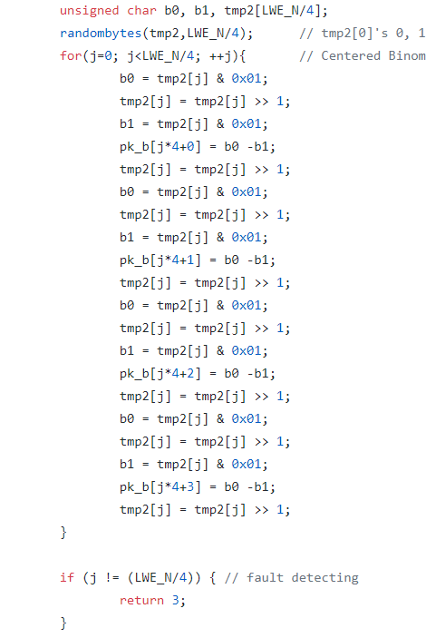
Resistance known side-channel attacks (2/2)
According to the 2nd strategy, added countermeasures against the remaining attacks.

